Slide 1
CS210: Computer Science II

Slide 2
Unit 1 Module 5
Abstract Data Types
Intro to Abstract Data Types
Using Abstract Data Types

Slide 3
Abstract Data Types
A data type that specifies
values that can be stored
operations that can be done on the values
User of an abstract data type does not need to know the implementation of the data type, e.g., how the data is stored
ADTs are created by programmers

Slide 4
Abstraction and Data Types
Abstraction: a definition that captures general characteristics without details
Ex: An abstract triangle is a 3-sided polygon. A specific triangle may be scalene, isosceles, or equilateral
Data Type defines the values that can be stored in a variable and the operations that can be performed on it
Typical operations on data when using ADTs – Add data to a data collection - Remove data from a data collection - Ask questions about the data in a data collection

Slide 5
Abstract Data Types
Data abstraction
Asks you to think what you can do to a collection of data independently of how you do it
Allows you to develop each data structure in relative isolation from the rest of the solution
A natural extension of procedural abstraction
A data type consists of a collection of values together with a set of basic operations defined on the values
A data type is an Abstract Data Type (ADT) if programmers using the type do not have access to the details of how the values and operations are implemented

Slide 6
Abstract Data Types
Abstract data type (ADT)
An ADT is composed of
A collection of data
A set of operations on that data
Specifications of an ADT indicate
What the ADT operations do, not how to implement them
Implementation of an ADT
Includes choosing a particular data structure

Slide 7
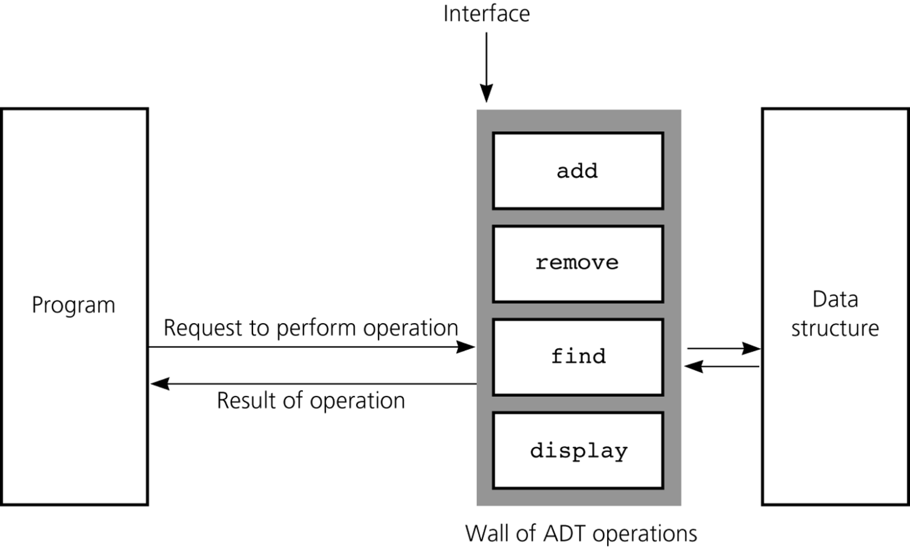
Abstract Data Types
A wall of ADT operations isolates a data structure from the program that uses it

Slide 8

Abstract Data Types

Slide 9
Classes To Produce ADTs
A class is a type that you define, as opposed to the types, such as int and char, that are already defined for you.
A value for a class type is the set of values of the member variables.

Slide 10
Classes To Produce ADTs
To define a class so it is an ADT
Separate the specification of how the type is used by a programmer from the details of how the type is implemented
Make all member variables private members
Basic operations a programmer needs should be public member functions
Fully specify how to use each public function
Helper functions should be private members

Slide 11
ADT Interface
The ADT interface tells how to use the ADT in a program
The interface consists of
The public member functions
The comments that explain how to use the functions
The interface should be all that is needed to know how to use the ADT in a program

Slide 12
ADT Implementation
The ADT implementation tells how the interface is realized in C++
The implementation consists of
The private members of the class
The definitions of public and private member functions
The implementation is needed to run a program
The implementation is not needed to write the main part of a program or any non-member functions

Slide 13
ADT Benefits
Changing an ADT implementation does require changing a program that uses the ADT
ADT’s make it easier to divide work among different programmers
One or more can write the ADT
One or more can write code that uses the ADT
Writing and using ADTs breaks the larger programming tasks into smaller tasks

Slide 14
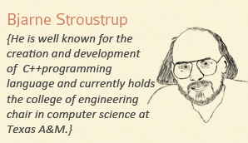

I thought an ADT was an Akron Devo Tribute?

Slide 15
References
Slide contributions include:
Walter Savitch, Problem solving with C++ (9th Edition). Addison-Wesley Longman Publishing Co., Inc. Boston, MA, USA ©2015
Gaddis, Starting Out with C++: From Control Structures through Objects, (8th Ed.) , Addison-Wesley Longman Publishing Co., Inc. Boston, MA, USA ©2015
Bjarne Stroustrup, The C++ Programming Language, 3rd Edition, Addison-Wesley Longman Publishing Co., Inc. Boston, MA, USA ©2007
Herb Sutter, Andrei Alexandrescu, C++ coding standards : 101 rules, guidelines, and best practices, Copyright © 2005 Pearson Education, Inc.
Paul Deitel & Harvey Deitel, C++ How to Program, (7th Ed.) © 2010 by Pearson Education, Inc.
Upper Saddle River, New Jersey 07458
Scott Meyers, Effective Modern C++. Copyright © 2015 (O’Reilly) , 978-1-491-90399-5.
Andrew Koenig and Barbara E. Moo, Accelerated C++ Practical Programming by Example,
Addison-Wesley, 2000 ISBN 0-201-70353-X

